Slide 1
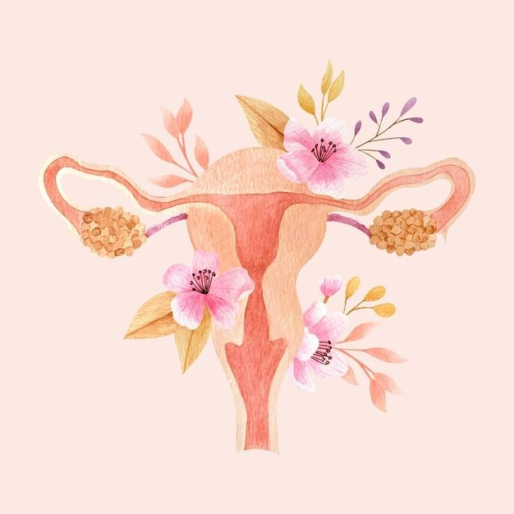
Safety and the Female
  Sul Ross State University
  Sex Talk and Women’s Health Care Seminar
  April 22, 2024
Sexual Response:
a Women’s Health Care Perspective on obligation sex versus relationship sex

Slide 2
Sharon Barrett
Fertility Educator & Women’s Herbalist
Midwifery Student
Soul Care Practitioner

Slide 3
Pop Quiz ☺
The Pill is known to _____ clitoral size and orgasms in women.
  Increase
  Decrease
  Not affect

Slide 4
Pop Quiz ☺
The Pill is known to _____ clitoral size and orgasms in women.
  Increase
  Decrease
  Not affect

Slide 5
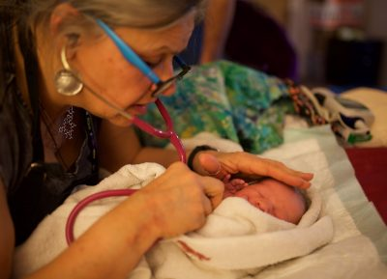
Community Midwives and…Sex?
  Physiological birth (labor that’s allowed to follow the normal hormonal cascade, not disturbed or rushed)
  Psychological safety (dark, quiet, private, familiar space with no strangers)

Slide 6
Community Midwives and…Sex?
  Sex is part of the fertility continuum (a universal lifespan process that connects us to our ancestors and descendants)
  preconception and conception
  pregnancy and birth
  the Babymoon and Fourth Trimester
  breastfeeding and weaning
  childhood to adulthood and building a new family

Slide 7

Oxytocin: The Hormone
Hormone that plays an important role in social bonding, social learning, and cardiovascular function
Discovered in 1906
The first polypeptide hormone to be synthesized (1953), leading to a Nobel Prize
We have oxytocin receptors throughout the body, with concentrations in the uterus, testes, mammary glands, and heart

Slide 8
Oxytocin: The Hormone
“The Love Hormone”/ “The Shy Hormone”
Creates “warm fuzzies”
  feelings of calm, connection, contentment, closeness, and caring
  reduces blood pressure, inhibits cortisol, promotes healing

Slide 9

Oxytocin: The Hormone
“The Love Hormone”/ “The Shy Hormone”
Released from the pituitary gland during activities that involve social bonding, such as:
    cuddling
    sexual arousal & intercourse to orgasm
    labor & childbirth
    breastfeeding

Slide 10
Oxytocin: The Hormone
In a physiological birth where the mother feels psychologically safe:
      Stimulates contractions
      Initiates a positive feedback loop
        Harder, faster contractions
        Increased pain tolerance
      Stimulates FER (fetal ejection reflex)

Slide 11

Oxytocin: The Hormone
“The power that got the baby in is the power that gets the baby out”
-midwife Ina May Gaskin

Slide 12

Oxytocin: The Hormone
Right after birth, everyone in the room is bathed in oxytocin:
Mom
Dad
Baby
Siblings
Attendants
The Golden Hour

Slide 13

Oxytocin: The Hormone
The Babymoon
Milk ejection reflex
Shrinks uterus back to pre-pregnancy size
Protective against feelings of sadness/anxiety

Slide 14

Oxytocin: The Hormone
The Fourth Trimester
Social and emotional growth for baby
Confidence for new parents
Integration of the newborn family into the wider social network

Slide 15
Oxytocin: The Hormone
Community midwives are oxytocin specialists

Slide 16
Oxytocin: The Hormone
In a sexual relationship where the woman feels physically and psychologically safe:
      Able to relax and reach full arousal
      Able to communicate with her partner
        What feels good
        What may be uncomfortable or painful
      Greater orgasmic frequency
Oxytocin is the foundation of female sexual response.

Slide 17
The Body, Sex, and Love
    The foundation of consent
      A person is meant for relationship with others
      A person only exists in a body
      The body is an expression of the person
I’m not just a body. I’m somebody.

Slide 18
The Body, Sex, and Love
The foundation of consent
  The meaning and purpose of being human is to love
  Having a body means I can participate in the mystery of giving and receiving love
  It sets me free to make the choice to love or not to love

Slide 19
The Body, Sex, and Love
The foundation of consent
    “Freedom is given for love. It can lead to destruction and division, but it’s intended to bestow life and establish unity. It’s our choice.”
      -Christopher West, Theology of the Body for Beginners

Slide 20
The Body, Sex, and Love
The foundation of consent
  “Intimate sex requires that you feel as if your spouse values you not just for what you can give them but for who you are.”
  However, “sex divorced from intimacy can widen the chasm between two people.”
    -Sheila Gregoire, The Great Sex Rescue
Obligation sex inhibits female sexual response.

Slide 21

Safety and Female Sexual Response
Threats to safety:
Cultural messages/internalized beliefs about obligation sex
  “It’s the right men feel to sexual pleasure, how dejected and even potentially angry they become when denied it.”⁠
-Peggy Orenstein, Boys & Sex

Slide 22
Safety and Female Sexual Response
Threats to safety:
Cultural messages/internalized beliefs about obligation sex
    “Transaction: I did this, so you owe me. Obligation: You owe me. Coercion: You owe me, so I’m going to take what I want.”
    --Sheila Gregoire, The Great Sex Rescue

Slide 23
Safety and Female Sexual Response
Two types of obligation sex:
Within a relationship
Gregoire et al. (2021): study of 20,000 married evangelical women
Outside of a relationship
Armstrong et al. (2012): study of 15,000 heterosexual undergraduates

Slide 24
Safety and Female Sexual Response
When a woman’s physical or psychological safety is threatened:
  Feelings of calm, connection, contentment, closeness, and caring are lost
  Nervous system may engage in fight, flight, fawn, or freeze
    Stress hormones (adrenaline, cortisol) replace oxytocin
  May feel detached or disconnected from her body and partner (mild to severe dissociation)

Slide 25
Safety and Female Sexual Response
Outcomes of Obligation Sex:
Female sexual pain
  The Great Sex Rescue study: one third of respondents
  estimated 18-28% of women worldwide
  can be physiological or psychological in origin
The “orgasm gap”
  The Great Sex Rescue study: 95% of men almost always/always orgasm during a sexual encounter, vs. 48% of women
  national average: 3 to 1 in favor of men

Slide 26
Safety and Female Sexual Response
Cultural messages/internalized beliefs - within a relationship
I have to have sex to prevent my partner’s porn use
  19% more likely to experience sexual pain
  24% less likely to orgasm reliably
I’m obligated to have sex whenever my husband wants it
  37% more likely to experience sexual pain
  29% less likely to frequently orgasm

Slide 27
Safety and Female Sexual Response
Cultural messages/internalized beliefs - outside of a relationship
Hookups are a low-risk way to enjoy sex in college
Being drunk allows you to hook up with anyone without commitment
It’s acceptable for men to pressure women for sexual acts
Hookups are about male pleasure
  A woman who asks a male hookup partner to prioritize her pleasure is rude and demanding
  A woman should feel guilty for expecting a hookup partner to give her an orgasm
  A woman should do whatever she can to bring her male partner to orgasm during a hookup

Slide 28
Safety and Female Sexual Response
The hookup orgasm gap (Armstrong et al., 2012):
  Initial hookup: man 31%, woman 10% (orgasm gap 3.1:1)
  Repeated encounters with same partner: orgasm gap shrinks each time
  In a relationship: man 85%, woman 68% (orgasm gap 1.25:1)
      Study Participant: “I’m all about just making her orgasm.”
      Interviewer: “The general her or like the specific her?”
      Participant: “Girlfriend her. In a hookup her, I don’t give a shit.”

Slide 29
Emotional Safety and Hooking Up
85% of college women would prefer not to hook up
  Most women want to reserve sex for an exclusive bonded relationship characterized by mutual commitment and caring (for the majority, this means marriage)
15% willingly and regularly hook up (this group accounts for 50% of hookup encounters)

Slide 30
Emotional Safety and Hooking Up
30% opt out of hooking up
55% hook up against preference

Slide 31
Emotional Safety and Hooking Up
So why do women participate in hookups?
55% of college women hook up because of social pressure
  Overestimate how often their peers are hooking up
  Afraid of losing their chance at a career if they commit to a relationship in college
  Social activities and dorm life center around sex
  Pressured by men into sexual acts
  Feel compared to dating apps, social media, and porn
  Are told they should only sleep with the guys they don’t like (to avoid “catching feelings”)

Slide 32
Emotional Safety and Hooking Up
Catching Feelings
“Saying we can have sex without emotions is like saying we can have sex without bodies.”
-Lisa Wade, American Hookup: The New Culture of Sex on Campus

Slide 33
Safety and Female Sexual Response
Armstrong et al. (2012): “relationship sex is better for women in terms of orgasm and sexual enjoyment”

Slide 34
Safety and Female Sexual Response
More oxytocin for her (calm, connection, contentment, closeness, and caring)
More vasopressin receptors for him (modulates testosterone, enables oxytocin) - stays in the brain if he’s around her but not having sex

Slide 35
Safety and Female Sexual Response
One in four college women reported being victimized in some way as a result of hookups (Online College Social Life Survey)
80% of campus sexual assaults occur during a hookup (Malone & Harris, Battles of the Sexes)
64% of freshman women who hook up do so under the influence of alcohol (Malone & Harris)
Hooking up has a greater negative impact on college women’s health, including mental health, than nutrition and exercise (Malone & Harris)

Slide 36
Safety and Female Sexual Response
  “Hookup culture…demands carelessness, rewards callousness, and punishes kindness. In this scenario, both men and women have the opportunity to have sex but neither is entirely free to love.”
  -Lisa Wade, American Hookup: The New Culture of Sex on Campus

Slide 37
Community and Online Resources
  Family Crisis Center of the Big Bend (Alpine, Presidio, Terlingua) - fccbb.org
  Singing Rose Tea & Soul Care (Presidio & virtual) - singingrose.me
  Anthus Women’s Health Collaborative (Midland) - anthusmidland.com
  Natural Womanhood - loveandfidelity.org
  Love & Fidelity Network - loveandfidelity.org
  Sex IQ and Empowering Smarter Sexuality - sexiq.org

